Slide 1

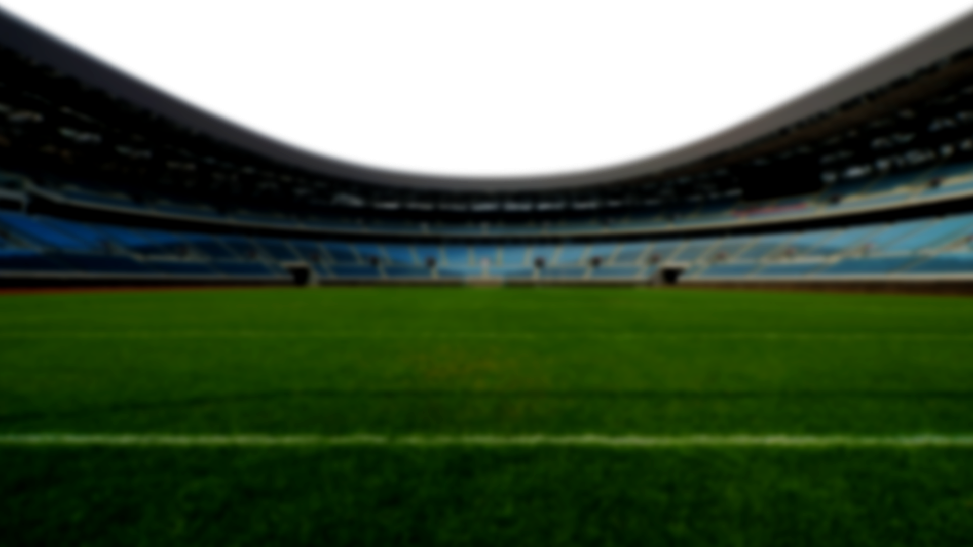




Using Auto Generated Data To Analyze Player Value
FIFA WORLD CUP

Slide 2
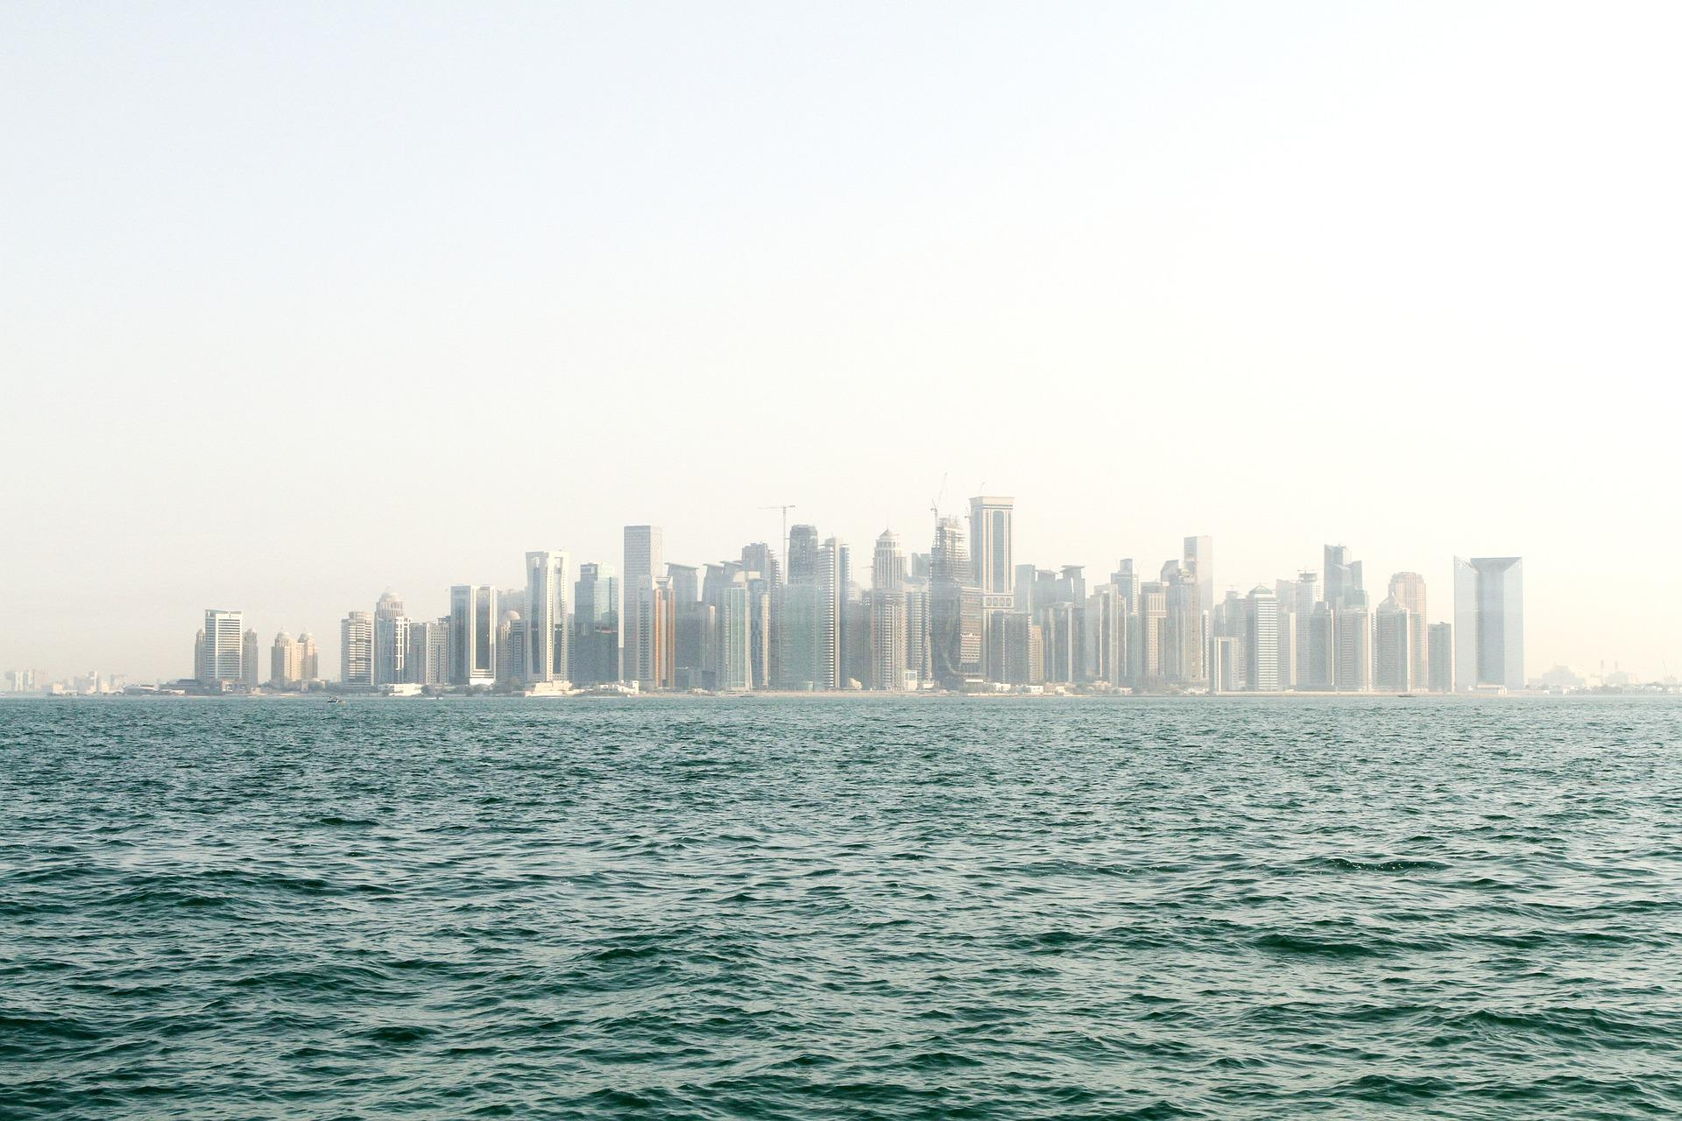
Task
FIFA WORLD CUP
Generate a report that ranks a player on quickness
Some key questions to answer:
What is the definition of quickness? What are the pros and cons of this definition?
Describe your general approach and any difficulties you encountered
What would you do differently if you had more time/data?
How would your approach differ if you had access to a controlled environment and could test players?

Slide 3
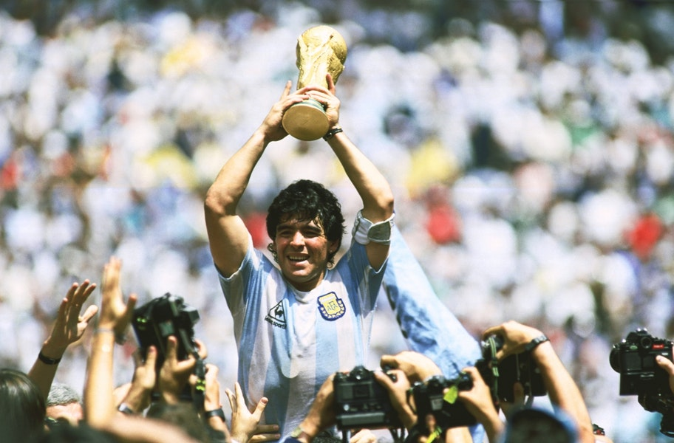
Definition
FIFA WORLD CUP
Quickness = Speed --> Defined as Speed = Distance / Time
There are 2 types of speed that we are interested in: Onball and offball
Onball: When player has possession of the ball
Offball: When possession of ball is with another player (other than the player we are interested in
For each of these speed (i.e. onball/offball/overall speed), we will also take into consideration whether the player’s team was in possession.
E.g. if team is in possession:
speed_teampos_onball: Onball speed while team was in possession
speed_teampos_offball: Offball speed while team was in possession

Slide 4
General Approach
1. Measure the distance moved from frame to frame at a frame rate of n (code).
a. Measuring the distance moved by the player as the frame moves.
This is done by comparing the (x, y) coordinates between 2 frames, i.e. frame vs frame + n. For the analysis, I chose n=1.
b. Measure the time past. Time past = n * 0.10 seconds
2. Next, we split this movement into onball and offball movement.
3. We further drill down into whether the onball/offball movement when in tandem with moments when the team was on/off possession.
Important Assumptions To Note:
Intent of the player is not captured. For e.g., when you are defending, you have less motivation to run at top speed since you may be adopting tactical defending.
There are moments that may not be captured in the data, but it doesn’t mean the player wasn’t moving.
Distance moved may be subjective to frame rate smoothing.
Overall
Team
In Possession
Speed
Onball speed
Onball speed
Offball speed
Offball speed
Team
Off Possession
Offball speed
FIFA WORLD CUP

Slide 5
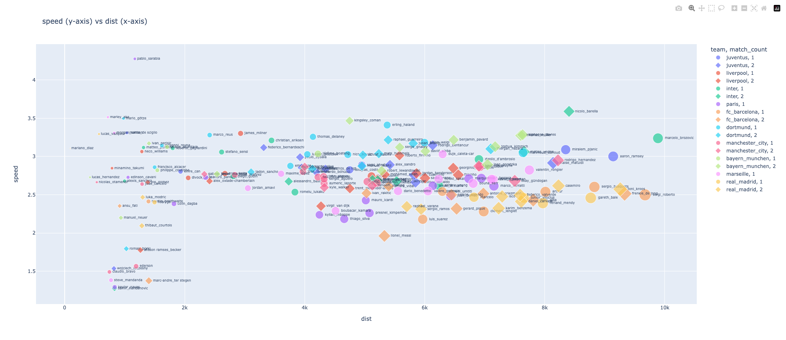
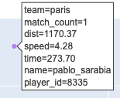
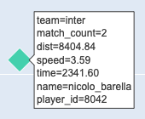
Overall Speed
FIFA WORLD CUP
Fastest player: Pablo Sarabia
But may not be fair because he was only on field for a few minutes (likely as a substitute)
Modified fastest player: Nicolo Barella
Note: Size of bubble = Time spent on field as captured by camera
The Plotly charts for the analysis can be found here.

Slide 6
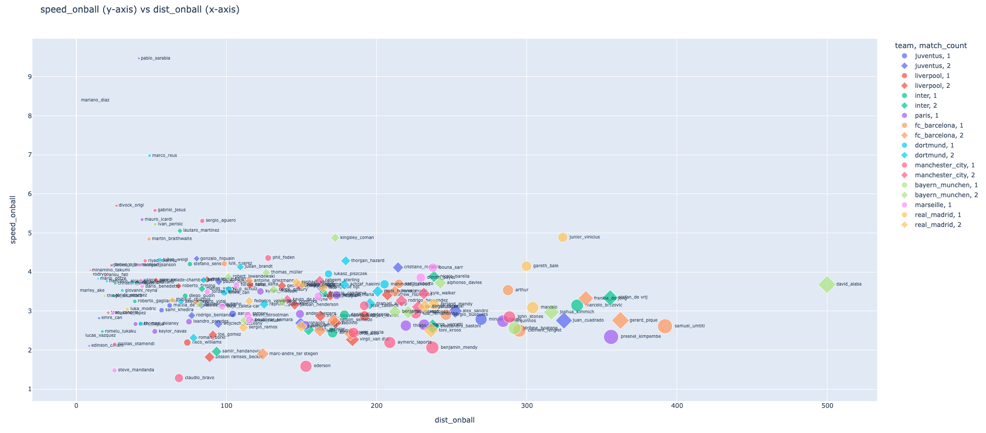
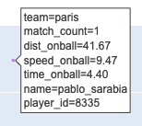
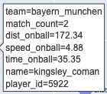
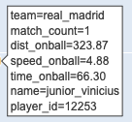
Onball Speed
FIFA WORLD CUP
Fastest player: Pablo Sarabia
But may not be fair because he was only on field for a few minutes (likely as a substitute)
Modified fastest player: Kingsley Coman
Modified fastest player: Vincius Jr
Note: Size of bubble = Time spent on field as captured by camera
The Plotly charts for the analysis can be found here.

Slide 7
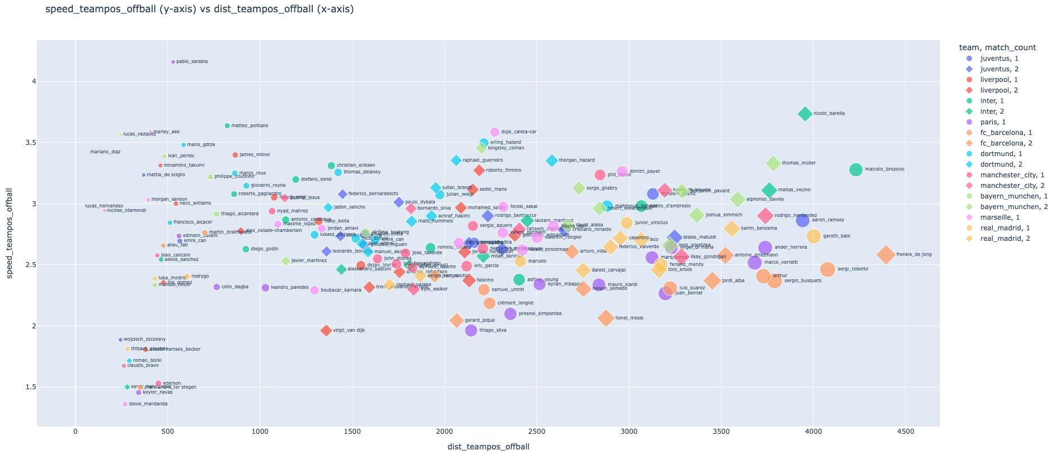
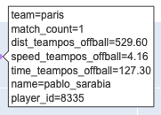
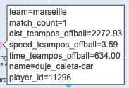
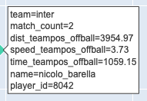
Offball Speed While Team In Possession
FIFA WORLD CUP
Fastest player: Pablo Sarabia
But may not be fair because he was only on field for a few minutes (likely as a substitute)
Modified 2nd fastest player: Duje Caleta-Car
Modified fastest player: Nicolo Barella
Note: Size of bubble = Time spent on field as captured by camera
The Plotly charts for the analysis can be found here.

Slide 8
Things To Do Differently
FIFA WORLD CUP
Refine Possession Definition
Combining Real-Time Match Stats
More Match Data For Validation
Validating Movement Data
Possession is currently defined based on the tracking data provided by SkillsCorner.
We can validate whether this is accurate by measuring the distance between the ball and the surrounding closest players.
As the match is taking place, real-time stats are being recorded.
Stats like current score, possession, player’s position all have an impact on the player’s distance ran and speed.
Therefore, we can combine these real-time stats to potentially improve our measurement.
If there’s more data, we will have a stronger statistical approach to the measurement of distance.
Currently, with only 2 matches max per player, it can skew the speed of each player.
For instance, we can see that those players who had lesser minutes tend to be “faster”.
In addition, we can also combine this data with highlights. This will help us to better identify key action frames within the match.
For now, we are assuming that the data provided by SkillsCorner is accurate. However, that may not be the case.
If we want to use the data at production level, it is best to backtest the data.
For e.g., we can select a couple of matches and key moments in the matches. Then we compare the position of the players we see on screen with the positions provided by SkillsCorner. It will not match 100%, but this will be indicative of whether the coordinate data is close to being accurate.
Movement Relative To Pitch
The pitch can be split into 3 thirds: Attacking, defensive, and middle third.
We can further analyze players’ movement in:
Each of the 3 thirds
Movement across the 3 thirds

Slide 9
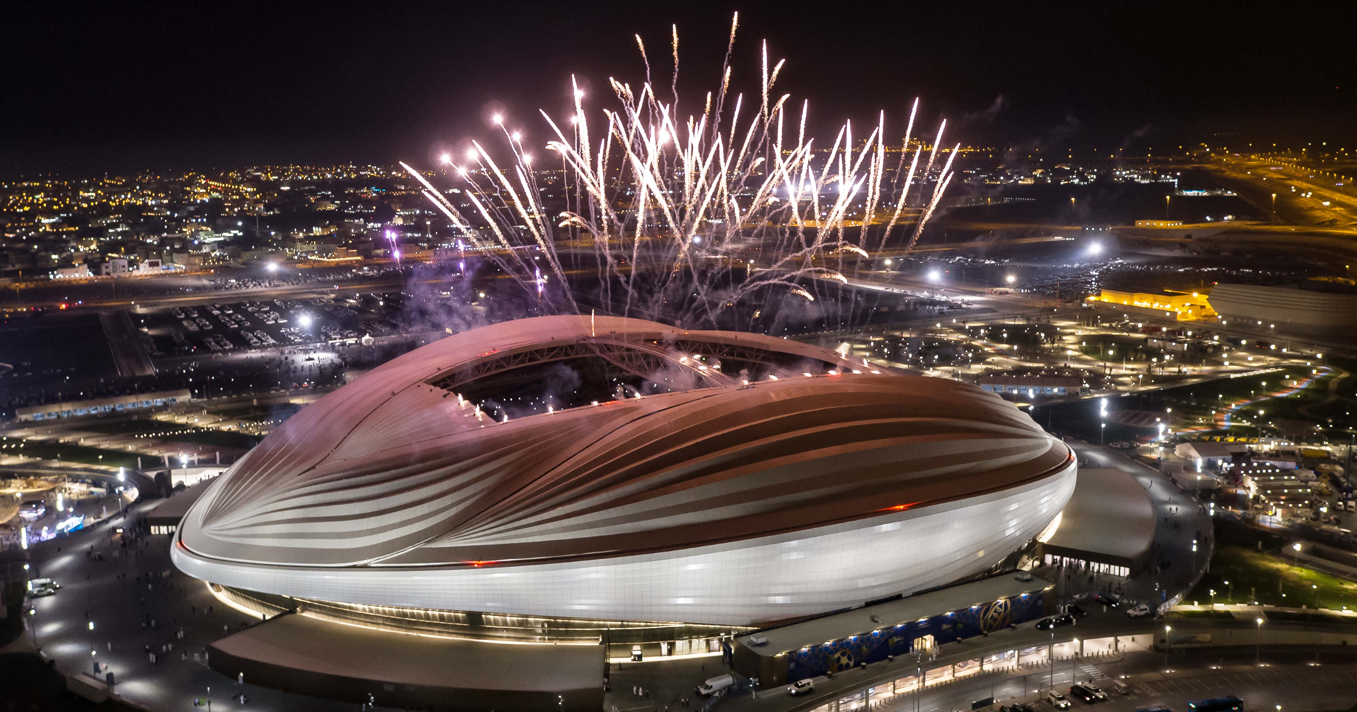
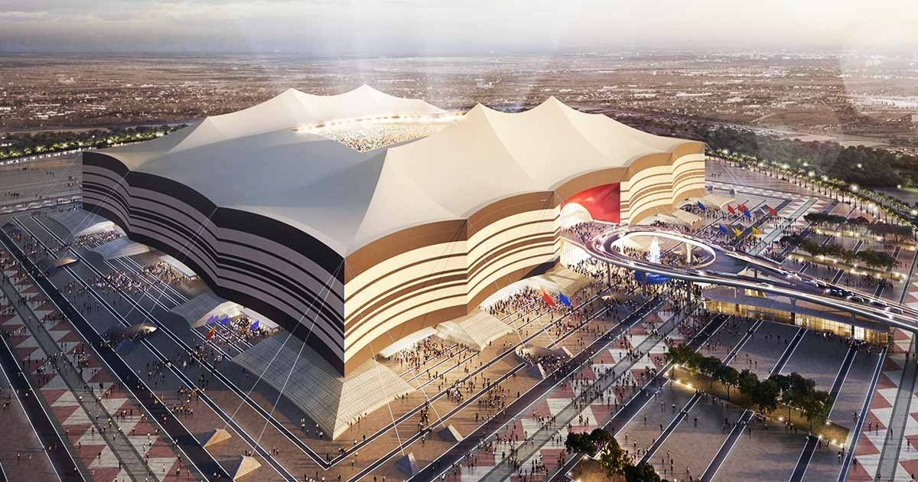
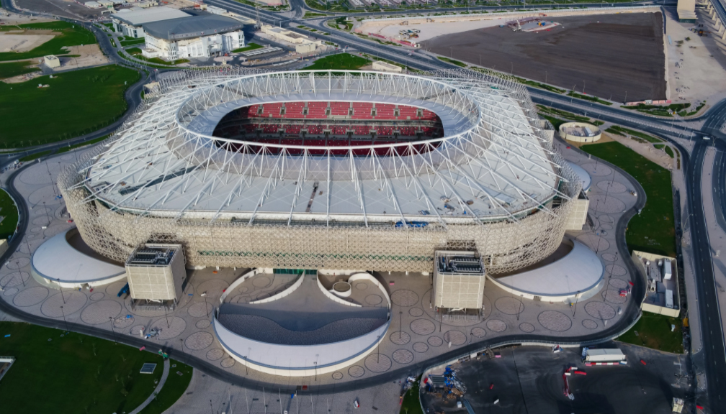
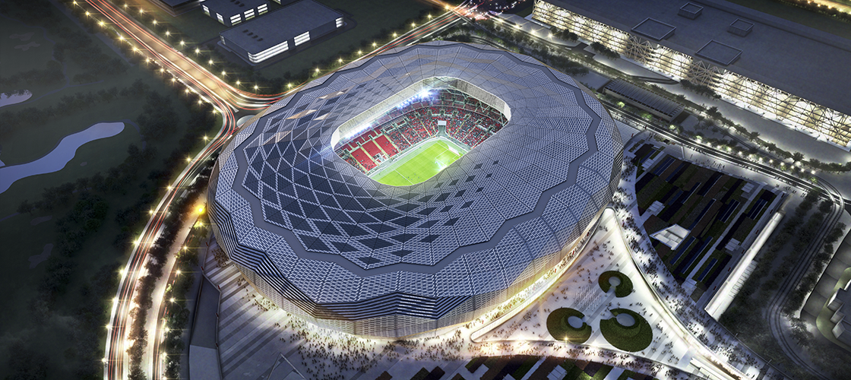
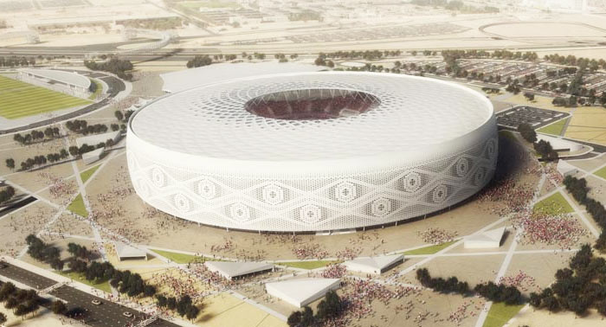
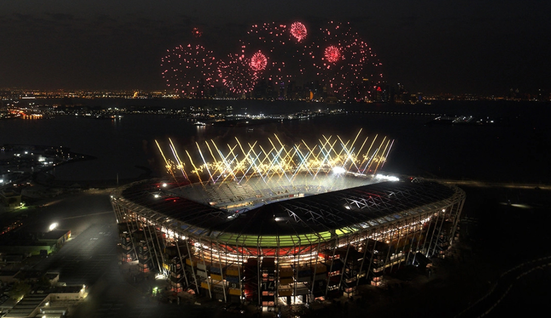
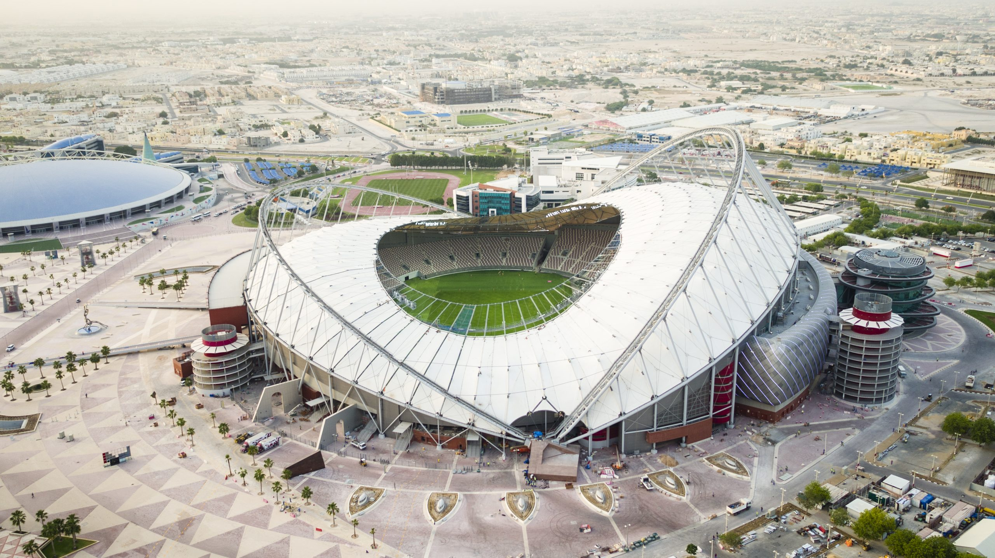
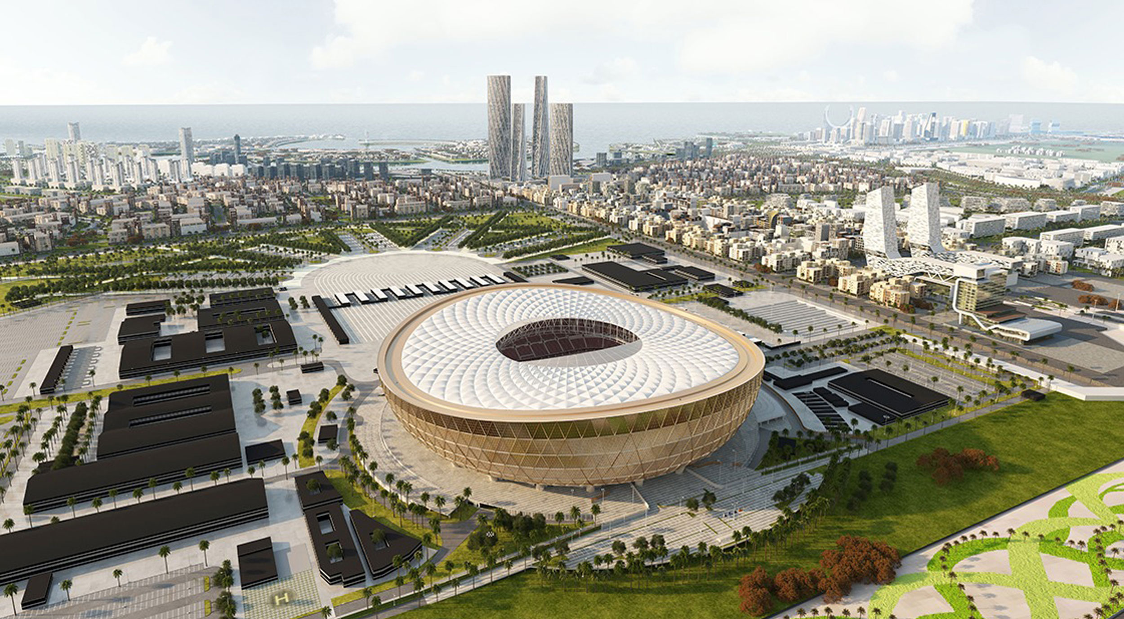
FIFA WORLD CUP
Stadiums in Qatar
Al Janoub
Al Bayt
Ahmad bin Ali
Education City
Al Thumama
Stadium 974
Khalifa International
Lusail

Slide 10
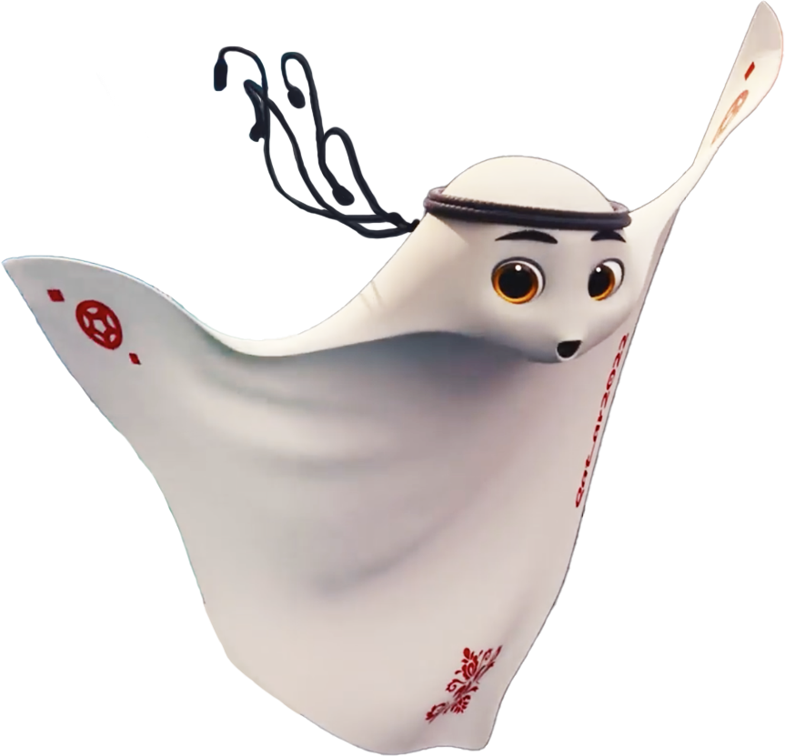
Meet La’eeb
La’eeb is an Arabic word meaning super-skilled player. He belongs to a parallel mascot verse that is indescribable — everyone is invited to interpret what it looks like. La’eeb, is playful, adventurous and curious and can be seen wearing the Qatari national dress.
FIFA WORLD CUP

Slide 11
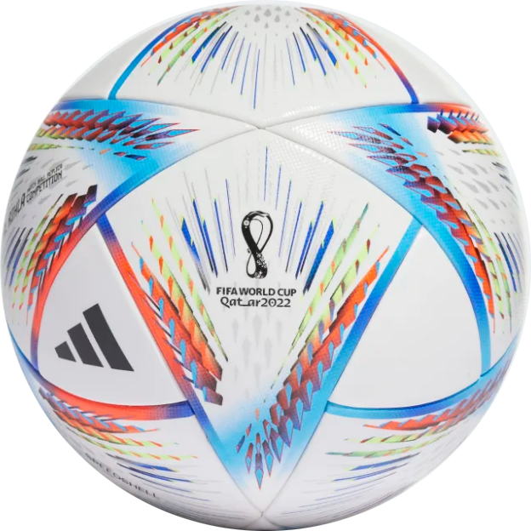
Official Ball
Al Rihla, the official Match Ball of 2022 FIFA World Cup in Qatar was unveiled by Adidas on 30th March 2022. Al Rihla translates as “the journey” in Arabic and has been inspired by the architecture, iconic boats, and the Flag of Qatar.
360° Full View
FIFA WORLD CUP

Slide 12
















Participating Teams
Group E
Group F
Group G
Group H
Spain
Belgium
Brazil
Portugal
Costa Rica
Canada
Serbia
Ghana
Germany
Morocco
Switzerland
Uruguay
Japan
Croatia
Cameroon
Korea Republic
FIFA WORLD CUP

Slide 13




Trophy Evolution (1930 - 2022)
Modern-day Fifa world cup design features two athletes’ bodies holding hands and supporting the earth.
Jules Rimet Trophy originally named Victory, but later renamed in honor of FIFA president Jules Rimet.
FIFA WORLD CUP

Slide 14
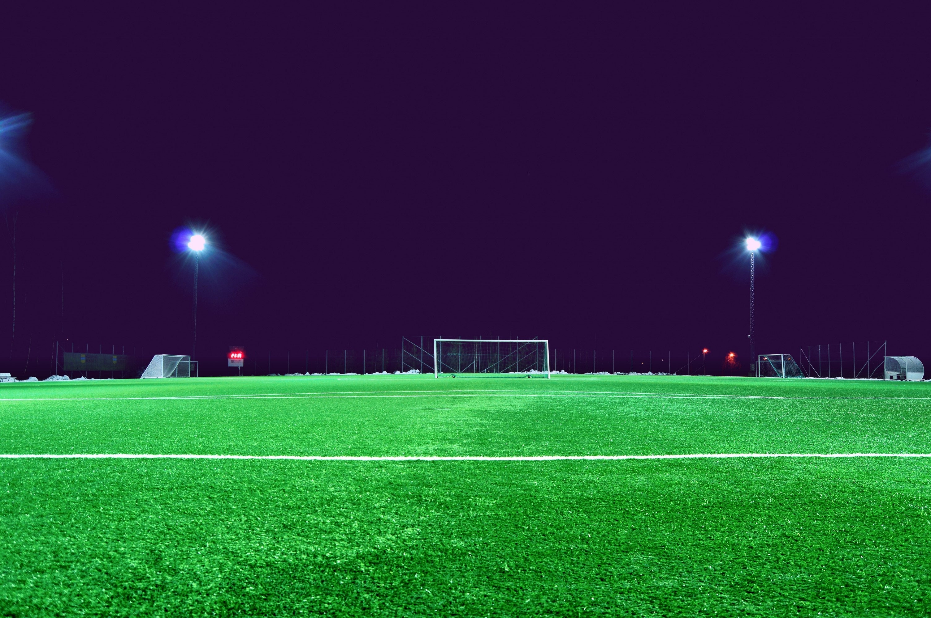








World Cup Fixtures
Arabia Standard Time (AST) UTC+03:00
01:00 pm
21 Nov 2022
04:00 pm
21 Nov 2022
Senegal
VS
Netherlands
England
VS
IR Iran
Monday
Al Thumama
Monday
Khalifa International
07:00 pm
21 Nov 2022
10:00 pm
21 Nov 2022
Qatar
VS
Ecuador
USA
VS
Wales
Monday
Al Bayt
Monday
Ahmad Bin Ali
FIFA WORLD CUP

Slide 15




Al Janoub Stadium
Arabia Standard Time (AST) UTC+03:00
10:00 pm
22 Nov 2022
01:00 pm
28 Nov 2022
France
VS
Australia
Cameroon
VS
Serbia
01:00 pm
24 Nov 2022
06:00 pm
30 Nov 2022
Switzerland
VS
Cameroon
Australia
VS
Denmark
01:00 pm
26 Nov 2022
06:00 pm
02 Dec 2022
Tunisia
VS
Australia
Ghana
VS
Uruguay
FIFA WORLD CUP

Slide 16
Al Bayt Stadium
Arabia Standard Time (AST) UTC+03:00
07:00 pm
21 Nov 2022
10:00 pm
27 Nov 2022
Qatar
VS
Ecuador
Spain
VS
Germany
01:00 pm
23 Nov 2022
06:00 pm
29 Nov 2022
Morocco
VS
Croatia
Netherlands
VS
Qatar
10:00 pm
25 Nov 2022
01:00 pm
01 Dec 2022
England
VS
USA
Costa Rica
VS
Germany
FIFA WORLD CUP

Slide 17

FIFA WORLD CUP
World Cup Facts
First Tournament
Most Wins
Most Losses
1930 (Uruguay)
Brazil (5 times)
Mexico (8 times)
Most Appearances
Most Goals
Fastest Goal Scorer
Brazil (22 times)
Miroslav Klose (Germany)
Hakan Sukur (Turkey)

Slide 18
Group Matches
21 Nov
Monday
22 Nov
Tuesday
23 Nov
Wednesday
24 Nov
Thursday
25 Nov
Friday
26 Nov
Saturday
27 Nov
Sunday
28 Nov
Monday
29 Nov
Tuesday
30 Nov
Wednesday
01 Dec
Thursday
02 Dec
Friday
Al Bayt
Stadium
QAT vs ECU
MAR vs CRO
ENG vs USA
ESP vs GER
NED vs QAT
CRC vs GER
19:00
13:00
22:00
22:00
18:00
22:00
Khalifa International
Stadium
ENG vs IRN
GER vs JPN
NED vs ECU
CRO vs CAN
ECU vs SEN
JPN vs ESP
16:00
16:00
19:00
19:00
18:00
22:00
Al Thumama Stadium
SEN vs NED
ESP vs CRC
QAT vs SEN
BEL vs MAR
IRN vs USA
CAN vs MAR
13:00
19:00
16:00
16:00
22:00
18:00
Ahmad Bin Ali Stadium
USA vs WAL
BEL vs CAN
WAL vs IRN
JPN vs CRC
WAL vs ENG
CRO vs BEL
22:00
22:00
13:00
13:00
22:00
18:00
Lusail Stadium
ARG vs KSA
BRA vs SRB
ARG vs MEX
POR vs URU
KSA vs MEX
CMR vs BRA
13:00
22:00
22:00
22:00
22:00
22:00
Stadium 974
MEX vs POL
POR vs GHA
FRA vs DEN
BRA vs SUI
POL vs ARG
SRB vs SUI
19:00
19:00
19:00
19:00
22:00
22:00
Education City Stadium
DEN vs TUN
URU vs KOR
POL vs KSA
KOR vs GHA
TUN vs FRA
KOR vs POR
16:00
16:00
16:00
16:00
18:00
18:00
Al Janoub Stadium
FRA vs AUS
SUI vs CMR
TUN vs AUS
CMR vs SRB
AUS vs DEN
GHA vs URU
22:00
13:00
13:00
13:00
18:00
18:00

Slide 19
Group Matches
03 Dec
Saturday
04 Dec
Sunday
05 Dec
Monday
06 Dec
Tuesday
09 Dec
Friday
10 Dec
Saturday
13 Dec
Tuesday
14 Dec
Wednesday
17 Dec
Saturday
18 Dec
Sunday
Al Bayt
Stadium
1B vs 2A
W51 vs W52
W59 vs W60
22:00
22:00
22:00
Khalifa International
Stadium
1A vs 2B
3rd Place
18:00
18:00
Al Thumama Stadium
1D vs 2C
W55 vs W56
18:00
18:00
Ahmad Bin Ali Stadium
1C vs 2D
Round 16
Quarter Finals
Semi Finals
3rd Place & Final
22:00
Lusail Stadium
1H vs 2G
W49 vs W50
W57 vs W58
Final
22:00
22:00
22:00
18:00
Stadium 974
1G vs 2H
22:00
Education City Stadium
1F vs 2E
W53 vs W54
18:00
18:00
Al Janoub Stadium
1E vs 2F
18:00

Slide 20
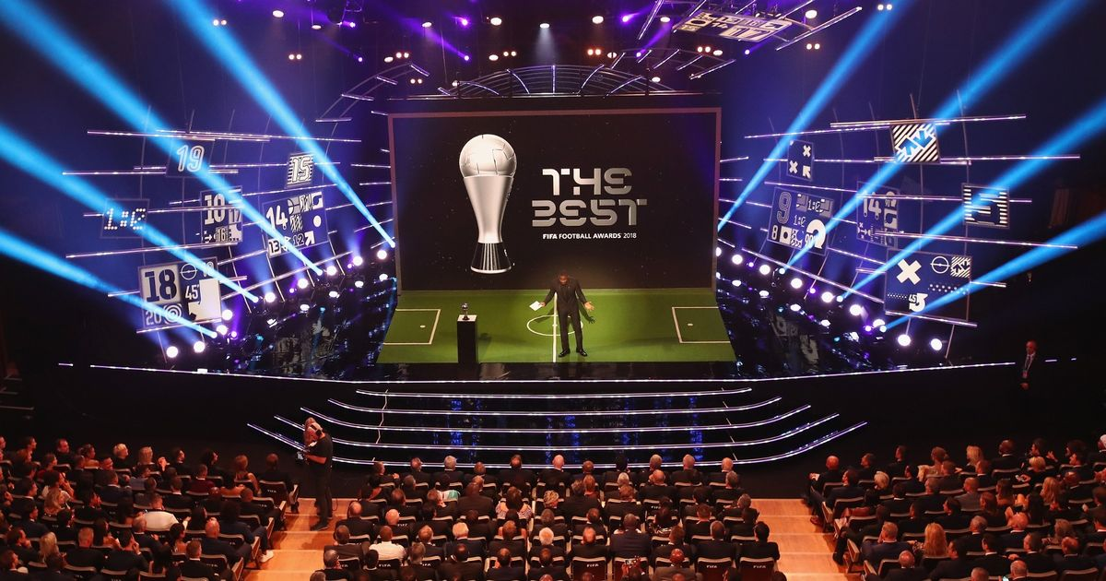

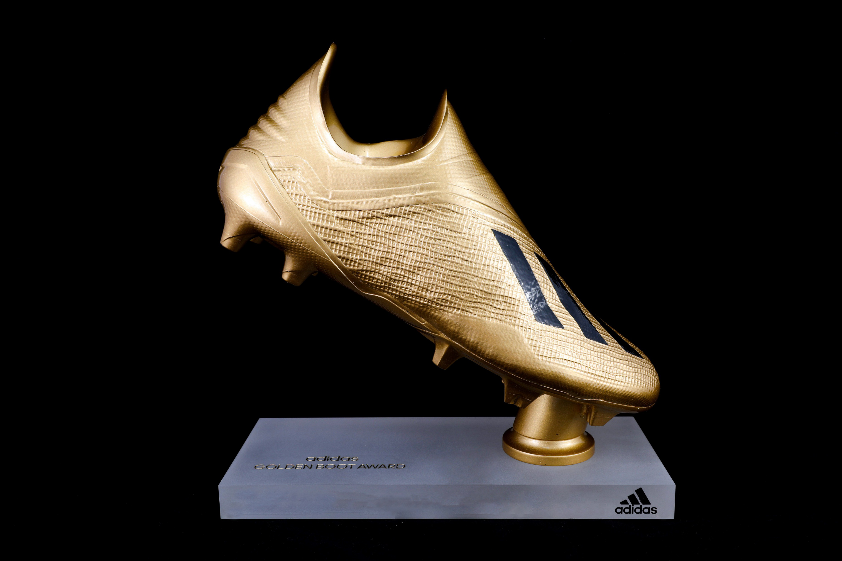

FIFA Awards
Golden Ball
Golden Boot
Golden Glove
Best Player
Top Goal Scorer
Best Goalkeeper

Slide 21








Organisers
FIFA Partners
Fédération Internationale de Football Association
Organising Committee for FIFA Competitions
FIFA World Cup Qatar 2022 LLC

Slide 22
Ticket Booking
The next opportunity to purchase tickets for the FIFA World Cup Qatar 2022™ will be a First Come First Served sales period. All purchases will be processed as real-time transactions, on a first come, first served basis, subject to availability. Tickets successfully purchased will be confirmed immediately to ticket applicants.
Visit:
FIFA.com/tickets
FIFA WORLD CUP

Slide 23
THANK YOU

Slide 24
INSTRUCTIONS FOR USE
You must credit Slidechef in order to use this template
What you are allowed to do :
Modify this template
Use it for personal or commercial projects
What you are not allowed to do :
Offer Slidechef templates for download
Sublicense, sell or rent any Slidechef content
Distribute Slidechef content unless it has been authorized
Include Slidechef content in an online or offline file
Acquire the copyright of Slidechef content

Slide 25

Slide Chef

